Slide 1
FPGA-Based Synthesis of a 16-bit High-Speed Hybrid Carry Select Adder SDG 9: Industry, Innovation, and Infrastructure
Team Members
Vaishnavi R (RA2211004050029)
Karlyn Cynthia FM (RA2211004050031)
Guided by
Dr. S Aditya
Assistant Professor
ECE

Slide 2
ABSTRACT
High-Speed Hybrid CSA – A 16-bit Carry Select Adder (CSA) designed for FPGA implementation on Xilinx Artix-7 using Vivado.
Optimized Carry Propagation – Uses CLAs at critical positions for fast carry propagation and RCAs at non-critical positions for area efficiency.
Binary to Excess-1 Converter – Enables parallel sum calculation, reducing delay.
Verilog Implementation – Coded in Verilog HDL with performance verification through delay and maximum frequency.

Slide 3
INTRODUCTION
Fast arithmetic operations
Carry Select Adder (CSLA) - find a balance between speed and area utilization
Integrating Ripple Carry Adders (RCAs) and Carry Lookahead Adders (CLAs)
A binary to excess-1 converter (BEC) is used in place of the RCA for Cin = 1
Multiplexers select sum and carry outputs efficiently, speeding up computation

Slide 4
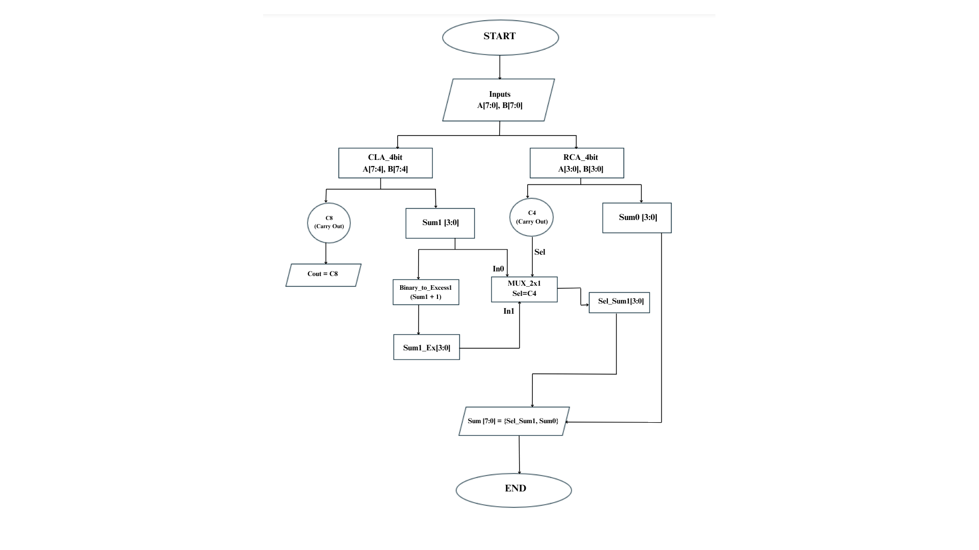
ALGORITHM

Slide 5
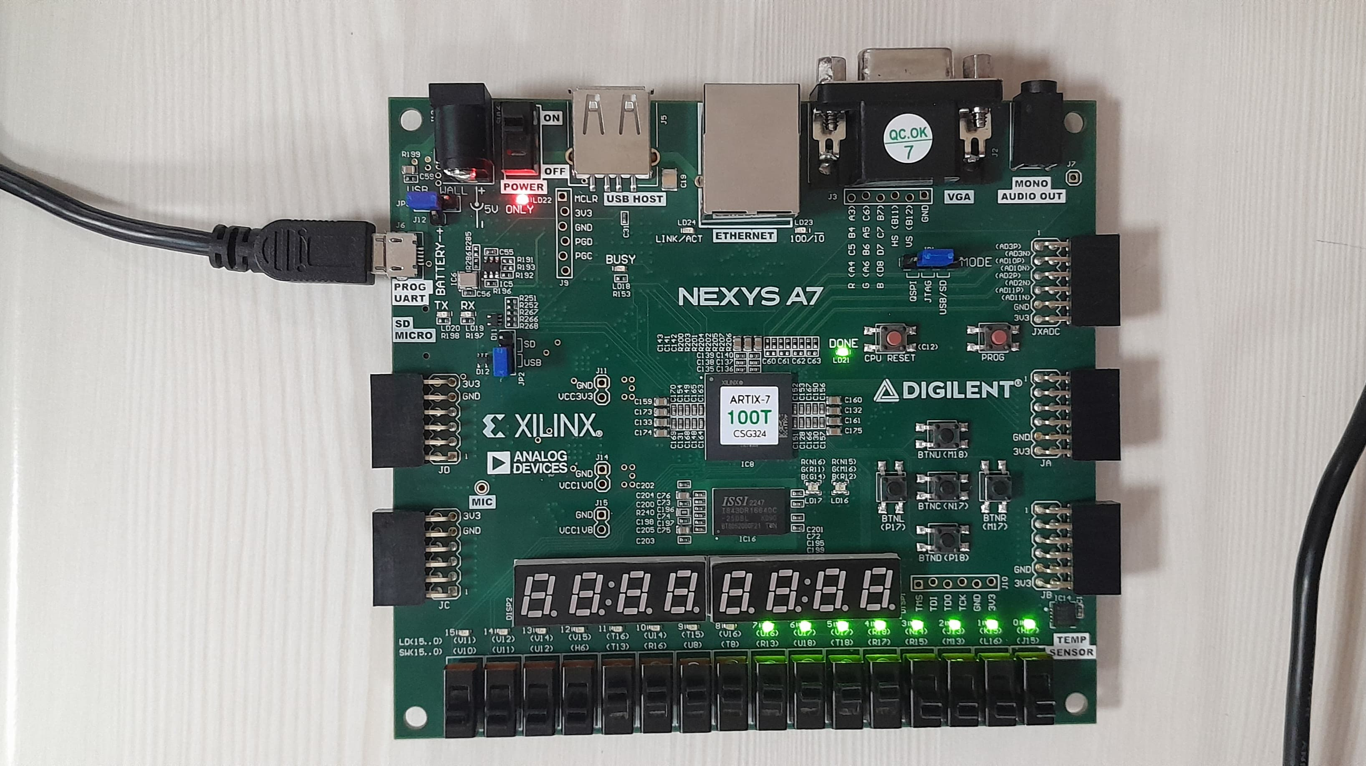
RESULT

Slide 6
RESULT-TESTCASES
TESTCASES | A (INPUT) | B (INPUT) | SUM (OUTPUT) | Cout (CARRY OUT)
1 | 00000000 | 00000000 | 00000000 | 0
2 | 00000011 | 00000101 | 00001000 | 0
3 | 10101010 | 01010101 | 11111111 | 0
4 | 11111111 | 11111111 | 11111110 | 1
5 | 00001111 | 00001111 | 00011110 | 0
6 | 11001010 | 10110101 | 01111111 | 1
7 | 11110000 | 00001111 | 11111111 | 0

Slide 7
THANK YOU!

